Slide 1
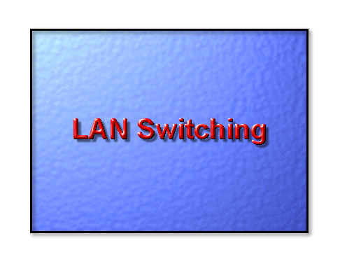

Slide 2
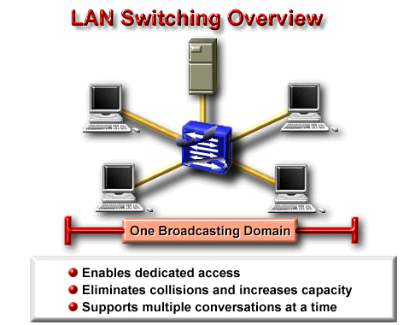

Slide 3
LAN Switching
A LAN switch is a device that provides much higher port density at a lower cost than traditional bridges. For this reason, LAN switches can provide fewer users per segment, thereby increasing the average available bandwidth per user .
The trend toward fewer users per segment is known as microsegmentation. Microsegmentation allows the creation of private or dedicated segments, that is, one user per segment. Each user receives instant access to the full bandwidth, and does not have to contend for available bandwidth with other users. As a result, collisions (a normal phenomenon in shared-medium networks employing hubs) do not occur.
A LAN switch forwards frames based on either the frame's Layer 2 address (Layer 2 LAN switch), or in some cases, the frame's Layer 3 address (multilayer LAN switch). A LAN switch is also called a frame switch because it forwards Layer 2 frames.
Layer 2 switches provides:
. Wire speed
. Low Latency
. Low Cost

Slide 4
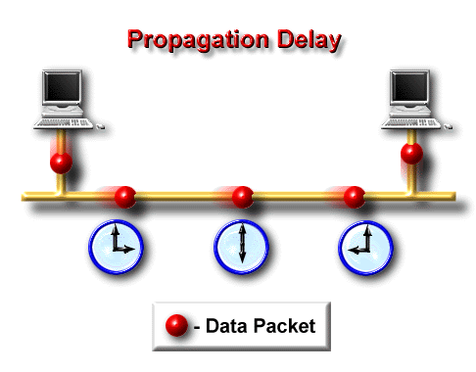
What is latency ?
1.) Delay between the time a device requests access to a network and the time it is granted permission to transmit.
2.) Delay between the time when a device receives a frame and the time that frame is forwarded out the destination port.

Slide 5
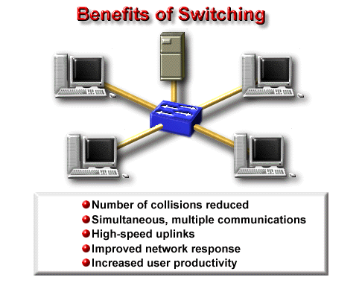

Slide 6
Bridging Vs. Switching
Bridging and switching are similar in some respects, but switching offers many advantages over bridging:
1. Switches are significantly faster because they switch in hardware, while bridges switch in software.
2. Switches can interconnect LANs of unlike bandwidth. For example, a 10-Mbps Ethernet LAN and a 100-Mbps Ethernet LAN can be connected using a switch.
3. Switches can support higher port densities than bridges.
4. Some switches support cut-through switching, which reduces latency and delays in the network. Bridges support only store- and-forward traffic switching.
5. Switches reduce collisions on network segments because they provide dedicated bandwidth to each network segment.
6. Bridging does offer some advantages over switching, including superior traffic filtering capabilities.

Slide 7
Switch Functions
Address learning: Layer 2 switches and bridges remember the source hardware address of each frame received on an interface, and they enter this information into a MAC database called a forward/filter table.
Forward/filter decisions: When a fram is received on interface the switch looks at the destination h/w address and finds the exit interface in the MAC database. The frame is only forwarded out the specified destination port.
Loop avoidance: if multiple connections b/w switches are created for redundancy purposes, network loops can occur. STP is used to stop network loops while still permitting redundancy.

Slide 8
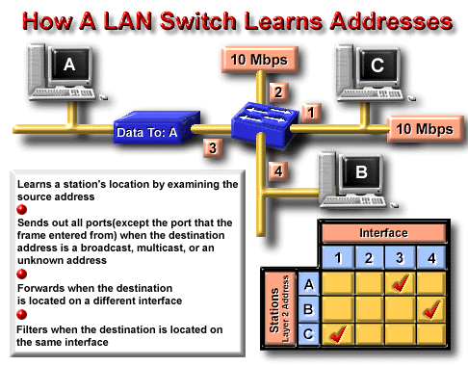

Slide 9
STP (Spanning Tree Protocol)

Slide 10
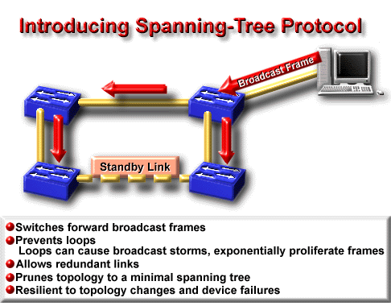
The main function of the Spanning-Tree Protocol (STP) is to allow redundant switched/bridged paths without suffering the effects of loops in the network.
Bridges and switches make their forwarding decisions for unicast frames based on the destination MAC address in the frame. If the MAC address is unknown, the device floods the frame out all ports in an attempt to reach the desired destination. It also does this for all broadcast frames.

Slide 11
The Spanning Tree Algorithm (STA), implemented by STP prevents loops by calculating a stable spanning-tree network topology. When creating fault-tolerant internetworks, a loop-free path must exist between all Ethernet nodes in the network. The STA is used to calculate a loop-free path. Spanning-tree frames called bridge protocol data units (BPDUs) are sent and received by all switches in the network at regular intervals and are used to determine the spanning tree topology.

Slide 12
A switch uses STP on all Ethernet and Fast Ethernet-based VLANs. STP detects and breaks loops by placing some connections in a standby mode, which are activated in the event of an active connection failure. A separate instance of STP runs within each configured VLAN, ensuring Ethernet topologies that conform to industry standards throughout the network.

Slide 13
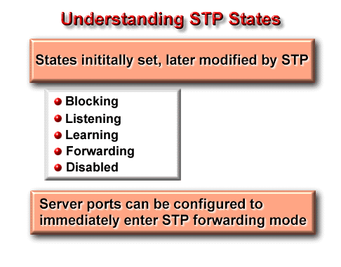
The supported STP states are as follows:
Blocking - No frames forwarded, BPDUs heard
Listening - No frames forwarded, listening for frames
Learning - No frames forwarded, learning addresses
Forwarding - Frames forwarded, learning addresses
Disabled - No frames forwarded, no BPDUs heard

Slide 14
LAN Switch Types
There are three switching modes that can be selected to forward frame through a switch.
Cut-through (FastForward) :When in this mode, the switch only waits for the destination hardware address to be received before it looks up the destination address in the MAC filter table.
FragmentFree (Modified cut-through): this is the default mode for 1900 switch. In this mode, the switch check the first 64 bytes of a frame before forwarding it for fragmentations.
Store-and-forward: In this, the complete data frame is received on the switch’ buffer, a CRC is run, and then the switch looks up the destination address in the MAC filter table.

Slide 15
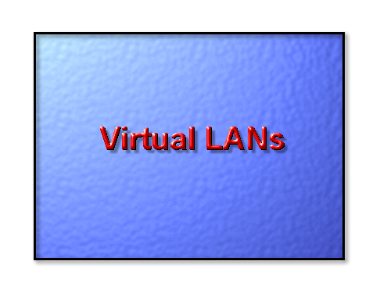

Slide 16
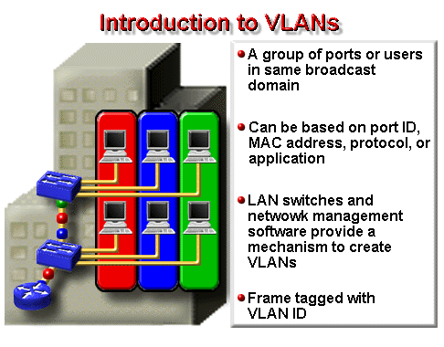
Administration
Engg.
Marketing

Slide 17
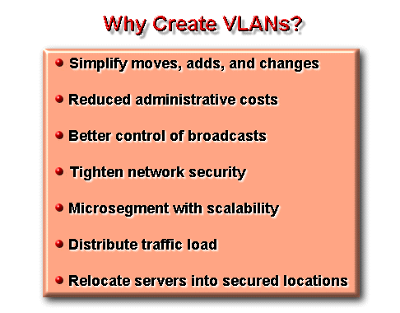

Slide 18
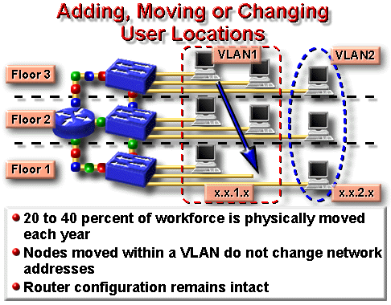

Slide 19
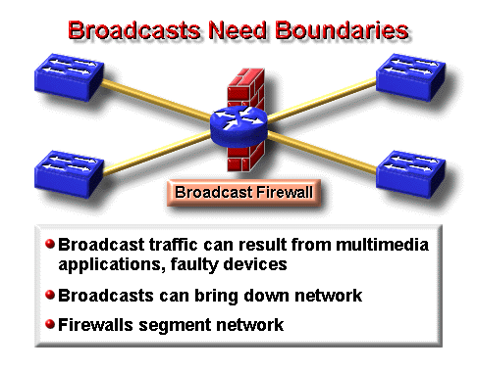

Slide 20
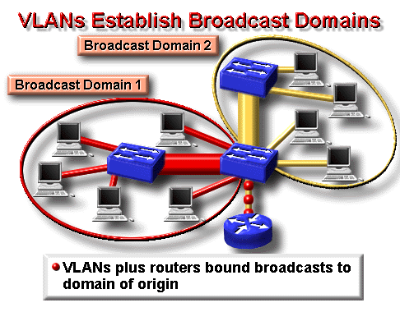

Slide 21
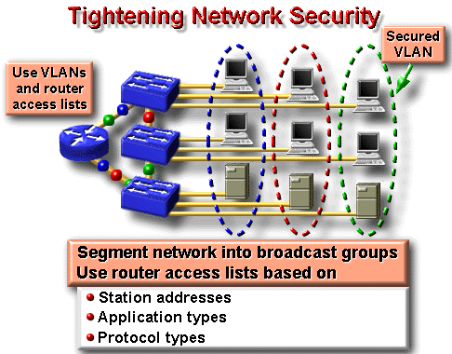

Slide 22
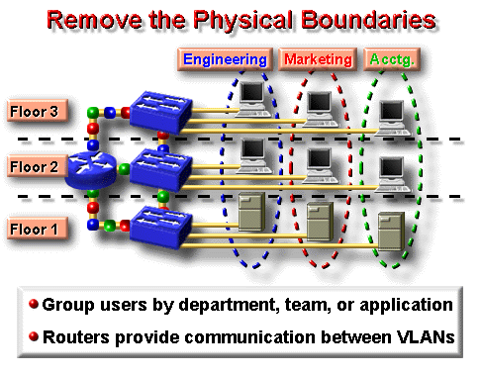

Slide 23
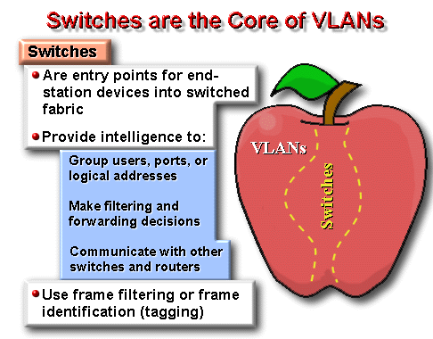

Slide 24
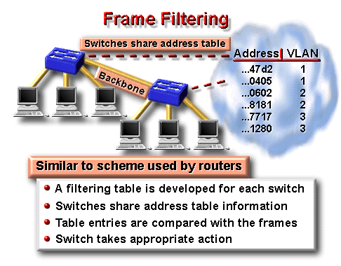
Frame filtering is a technique that examines particular information about each frame.
The concept of frame filtering is very similar to that commonly used by routers. A filtering table is developed for each switch, which provides a high level of administrative control because it can examine many attributes of each frame.

Slide 25
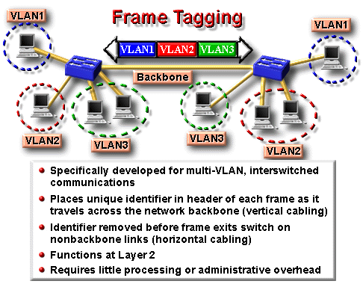
Frame identification (frame tagging) uniquely assigns a user-defined ID to each frame. This approach places a unique identifier in the header of each frame as it is forwarded throughout the network backbone. The identifier is understood and examined by each switch prior to any broadcasts or transmissions to other switches, routers, or end-station devices. When the frame exits the network backbone, the switch removes the identifier before the frame is transmitted to the target end station.

Slide 26
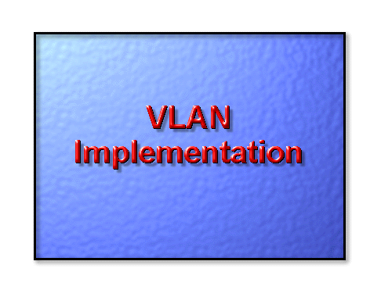

Slide 27
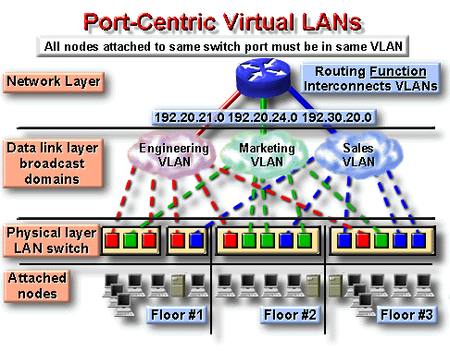
Users are assigned by port.
VLANs are easily administered Maximizes security between VLANs.
Packets do not “leak” into other domains.
VLANs and membership are easily controlled across network

Slide 28
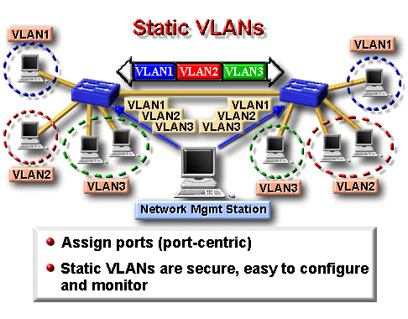
Static VLANs are ports on a switch that you statically assign to a VLAN. These ports maintain their assigned VLAN configurations until you change them. Although static VLANs require changes by you, they are secure, easy to configure, and straightforward to monitor. This type of VLAN works well in networks where moves are controlled and managed.

Slide 29
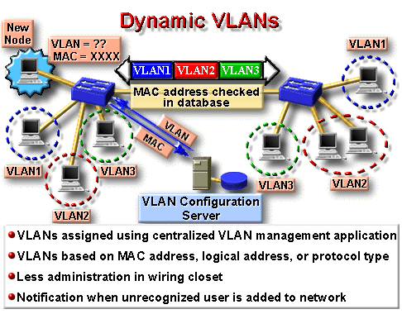

Slide 30
VLAN Identification Methods

Slide 31
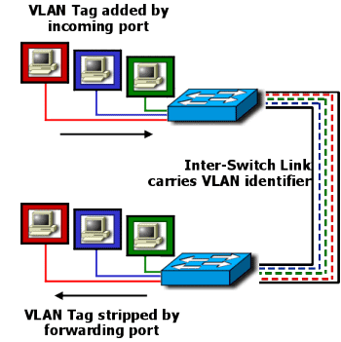
ISL (Inter-Switch Link)
ISL, Inter-Switch Link, is a Cisco proprietary protocol for interconnecting multiple switches and for maintaining VLAN information as traffic goes between switches.

Slide 32
Characteristics of ISL
ISL provides VLAN capabilities while maintaining full wire-speed performance
over Fast Ethernet links in full- or half-duplex mode.
ISL operates in a point-to-point environment.
ISL trunks enable VLANs across a backbone.
ISL is performed with ASIC.
ISL is not intrusive to client stations since the client does not see the ISL header.
VLAN Trunking Protocol
VLAN Trunking Protocol (VTP) is a protocol used to distribute and synchronize identifying information about VLANs configured throughout a switched network.
Characteristics
Configurations made to a single VTP server are propagated across links to all connected switches in the network.
VTP allows switched network solutions to scale to large sizes by reducing the manual configuration needs in the network.
VTP is a Layer 2 messaging protocol that maintains VLAN configuration consistency by managing the additions, deletions, and names changes of VLANs across networks.

Slide 33
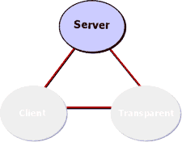
VTP minimizes misconfigurations and configuration inconsistencies that can
cause problems, such as duplicate VLAN names or incorrect VLAN-type
specifications.
A VTP domain is one switch or several interconnected switches sharing the
same VTP environment. A switch is configured to be in only one VTP domain.
VTP Modes
 | A Catalyst switch operating in the VTP Server mode can create, modify, and delete VLANs and other configuration parameters for the entire VTP domain. In this mode VLAN configurations are saved in the Catalyst nonvolatile memory. When you make a change to the VLAN configuration on a VTP server, the change is propagated to all switches in the VTP domain. VTP messages are transmitted out all trunk connections, such as ISL.

Slide 34
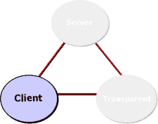
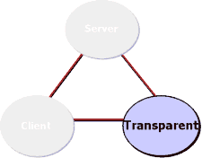
 | A device operating as a VTP Client cannot create, change, or delete VLANs. A VTP client does not save VLAN configurations in nonvolatile memory.
 | A switch operating in VTP Transparent mode does not create VTP advertisements or synchronize its VLAN configuration with information received from other switches in the management domain. A switch in transparent mode forwards VTP advertisements received from other switches that are part of the same management domain. A switch configured in VTP transparent mode can create, delete, and modify VLANs, but the changes are not transmitted to other switches in the domain; they affect only the local switch.

Slide 35
What is VTP Pruning?
VTP Pruning is a configuration that allows restricted traffic flow inside a management domain of a VLAN.
Purpose of VTP Pruning
VTP Pruning uses VLAN advertisements to determine when a trunk connection is flooding traffic needlessly. VTP pruning increases available bandwidth by restricting flooded traffic to those trunk links that the traffic must use to access the appropriate network devices.

Slide 36
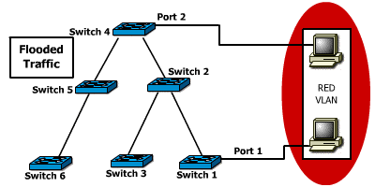
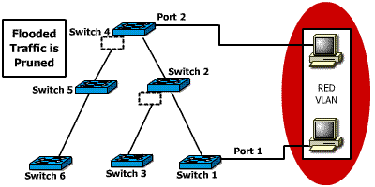
Slide Show Images | Text
 | By default, a trunk connection carries traffic for all VLANs in the VTP management domain. This creates wasted bandwidth due to excess flooding.
 | The figure shows a switched network with VTP pruning enabled. The broadcast traffic from station A is not forwarded to switches 3, 5, and 6 because traffic for the red VLAN has been pruned on the links indicated on switch 2 and 4.

